Slide 1
SIMPLE PRESENT TENSE
Rahma Aini, S.S., M.Pd.

Slide 2
What are the answers?
up / 7 / get / I / at
>> I get up at 7
2. tv / watch / they / sometimes
>> they sometimes watch TV.
3. goes / night / at / bed / to / he
>> he goes to bed at night.
4. often / plays / football / afternoon / in / the / he
>> he often plays football in the afternoon.
5. bus / takes / school / the / to / he
>> he takes the bus to school.

Slide 3
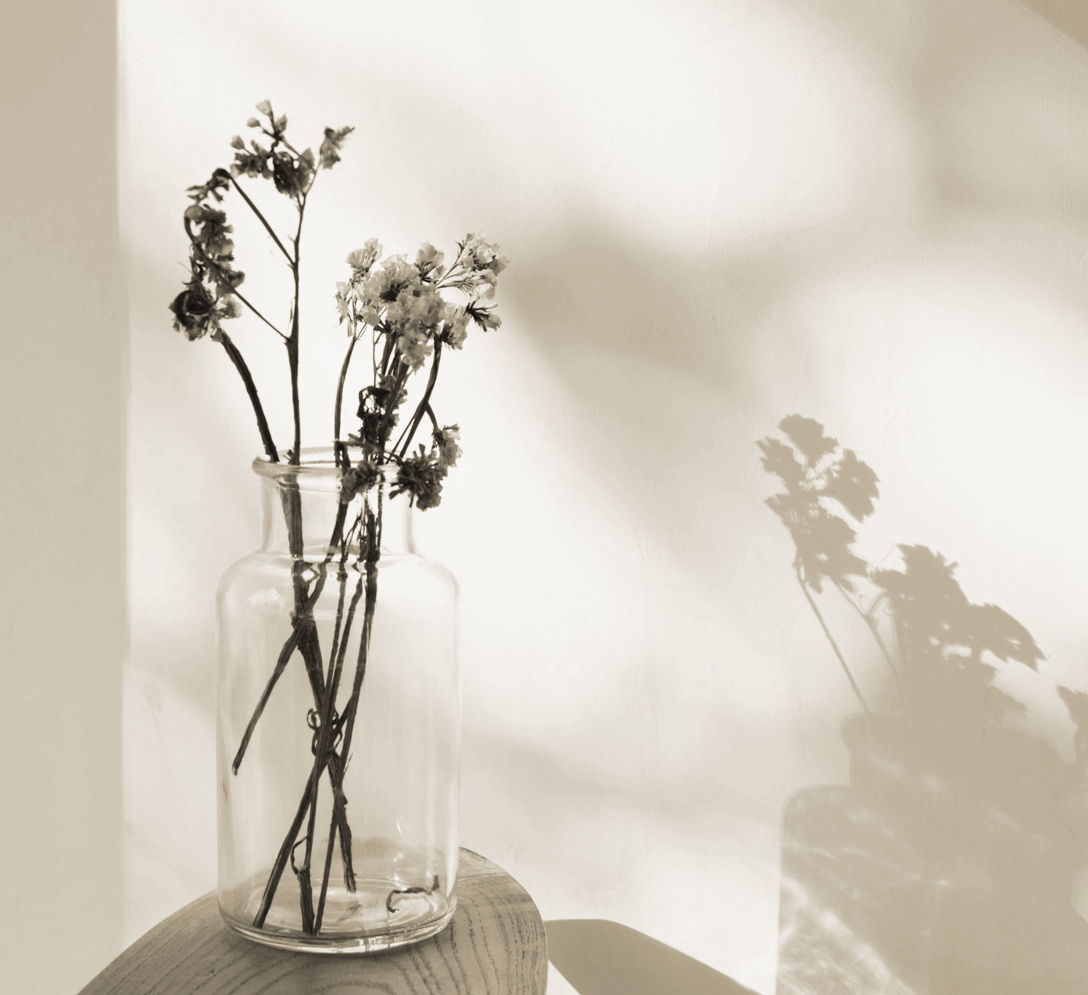
What is Simple Present Tense?
Simple present tense is used to say:
Habits and routines (kegiatan sehari-hari)
General truths and facts (kebenaran umum dan fakta)
Permanent situation (situasi permanen)
Schedules (jadwal)

Slide 4
Verbal Simple Present Tense
The sentence uses VERB.
Positive Sentence | I/YOU/THEY/WE + Verb 1 HE/SHE/IT + Verb 1 (s/es) | I go to campus every day. You always greet me. She usually cleans the class. He never cheats on his girlfriend.
Negative Sentence | I/YOU/THEY/WE + Don’t + Verb 1 She/He/It + Doesn’t + Verb 1 | I don’t go to campus every day. You don’t always greet me. She usually doesn’t clean the class. He doesn’t cheat on his girlfriend.
Interrogative Sentence | Do + I/YOU/THEY/WE + Verb 1 +? Does + SHE/HE/IT + Verb 1 + ? | Do you go to campus every day? Do they visit the museum? Does she clean the class? Does he cheat on his girlfriend?

Slide 5
Exercise
She ___ to music every night. (listen / listens)
They ___ in a big house. (live / lives)
We ___ not go to school on Sunday. (do / does)
___ he like pizza? (Do / Does)
I ___ (study) English every day.
The train ___ (leave) at 9:00 a.m.
My teacher ___ (not give) us homework on Friday.
Birds ___ (fly) in the sky.
___ your mother ___ (cook) dinner every evening?
He ___ (not play) football on Sundays.

Slide 6
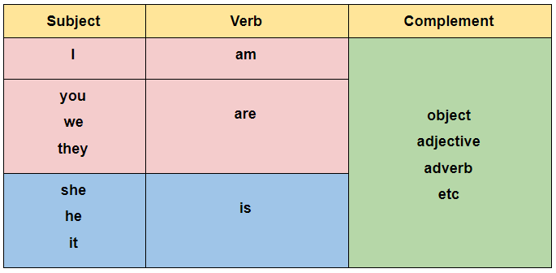
Nominal Simple Present Tense
The sentence uses NOUN/ADJECTIVES/ADVERBS.
(+) Subject + To Be (Is/Am/Are) + N/Adj/Adv
(-) Subject + To Be (Is/Am/Are) + NOT + N/Adj/Adv
(?) To Be (Is/Am/Are) + Subject + N/Adj/Adv?
Examples:
I am a student. You are not rich.
She is very tall. He is not my friend.
They are in the campus. We are not in the mall.

Slide 7
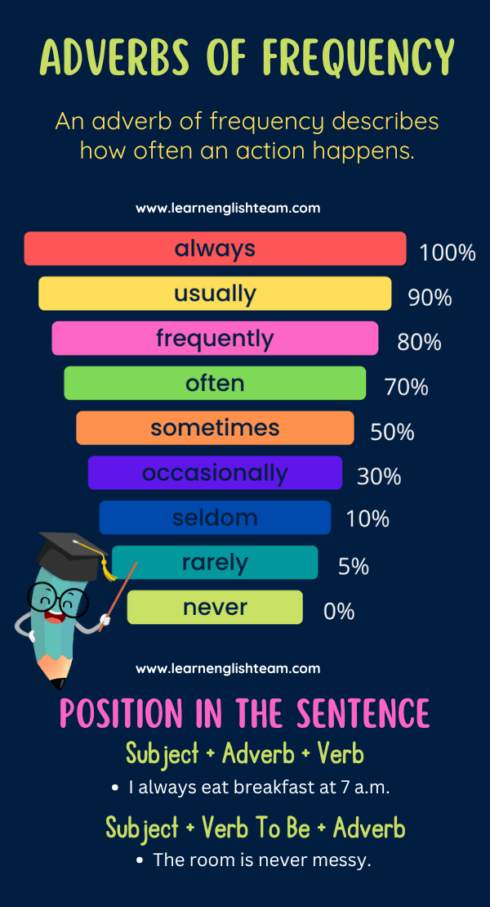
Adverb of Frequency
I usually wake up before 6 a.m. on weekdays.
I often read before going to bed.
She always takes the bus to school.
We rarely eat fast food because my dad likes cooking.

Slide 8
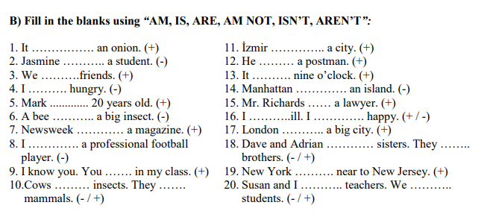
Exercise

Slide 9
Translate into English!
Saya biasanya bangun jam enam pagi.
Dia (perempuan) tidak suka kopi.
Kami selalu belajar bahasa Inggris pada hari Senin.
Mereka sering bermain sepak bola di sore hari.
Ayahku menonton televisi setiap malam.
Apakah kamu pergi ke kampus setiap hari?
Dia (laki-laki) tinggal di Jakarta.
Mereka tidak sibuk hari ini.
Mobil ini baru.
Apakah kalian senang?

Slide 10
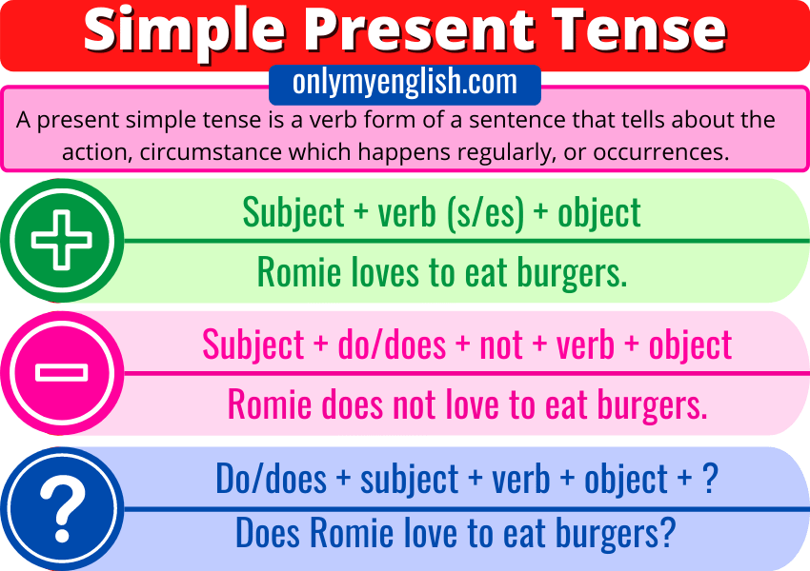
Verbal Simple Present Tense
Note:
I/YOU/THEY/WE >>> V1/ DO
HE/SHE/IT >>> V1 s/es / DOES
Ex:
We don’t watch horror movies.
She washes the dishes every day.

Slide 11
Vocabularies
Wake up
Wash your face
Take a bath
Dry your hair
Brush your teeth
Eat breakfast
Get dressed
Make your bed
Go to school
Study
Have lunch
Get home
Do your homework
Have dinner
Go to sleep

Slide 12
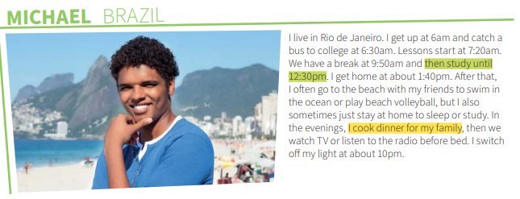
Skim the texts below!
What time does the speaker wake up?
How does the speaker go to college?
What does the speaker often do in the afternoon?
What does the speaker sometimes do instead of going to the beach?
What time does the speaker go to bed?
Which tense is used?

Slide 13
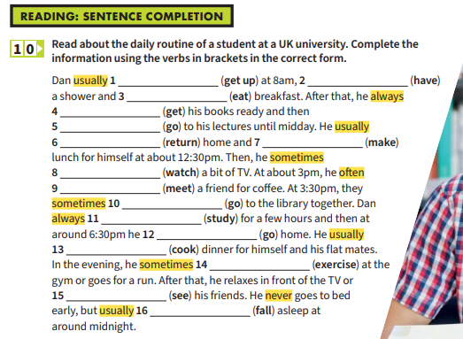
Exercise

Slide 14
Describing school and workplace
Describing a school or workplace means giving information about its location, size, facilities, people, activities, and atmosphere. It’s a descriptive task that combines factual details with personal impressions.

Slide 15
Vocabularies
Lecture
Subject
Major/Department
Dormitory
Tuition Fee
Short Course
State School
State University
Private University
Gpa (Grade Point Average)
Boarding School
Field Work
Internship
Bachelor Degree
Post Graduate Program
Graduation
Report
Research Paper
Assignments
Schedule

Slide 16
Role-play
James : Hello my name is James.
Diah : Hello James. My name is Diah.
Nice to meet you.
James : Nice to meet you too.
Diah : Are you in a vacation?
James : Yes, This is my first visit to indonesia.
Diah : Wow great. Where are you from?
James : I’m from U.S. Well, do you work or are you a student?
Diah : I’m a student at Muhammadiyah University of Surakarta.
James : What are you studying?
Diah : I’m studying nursing science. How about you? Are you a student?
James : Yes, I am studying anthropology.

Slide 17
Role-play
Caitlyn : What do you do?
Barry : I’m a doctor.
Caitlyn : oh, where do you work?
Barry : I work at Central Hospital.
Caitlyn : Oh, really? Where is that?
Barry : It is in Starling City. Where do you work?
Caitlyn : I work for Queen Industries. I am a secretary.
Barry : how do like it?
Caitlyn : it’s OK.

Slide 18
Expressions
Expressions | Responses
What are you studying? What are you majoring in? Where is your class? What is your favorite subject? Which subjects are you good at? Which subjects are you poor at? What's your father’s occupation? What do you do? What job do you want to have in five years’ time? Where do you work? What time do your start and finish work? | I’m studying English Literature. I’m majoring in English education. My class is on the third floor. My favorite subject is Geometry. I’m good at English. I’m poor at Mathematics. My father is a doctor. I am a teacher. I want to run my own company. I work for government office I start working at 8 and finish at 4 p.m.

Slide 19
Exercise
https://lbipu.ums.ac.id/wp-content/uploads/sites/72/2019/11/Materi-ETP-Unit-2-dan-3.pdf page 7

